Slide 1
RESEARCH BASED LEARNING

Slide 2
ANALYSIS ON DIABETES MELLITUS-BLOOD GLUCOSE PREDICTION USING MACHINE LEARNING ALGORITHMS
NAME: Radhika Gupta GUIDE’S NAME: Dr. Maria Anu V
Master of Computer Applications School of Computer Science and Engineering
Vellore Institute of Technology Vellore Institute of Technology
Chennai , India Chennai , India
radhika.gupta2022@vitstudent.ac.in mariaanu.v@vit.ac.
Reg no: 22MCA1119

Slide 3
ABSTRACT
Diabetes is a chronic disease with the potential to cause a worldwide health care crisis. Diabetes mellitus or simply diabetes is a disease caused due to the increase in level of blood glucose.
It is one of the growing extremely fatal diseases all over the world. Various traditional methods , based on physical and chemical tests , are available for diagnosing diabetes .
Data science methods have the potential to benefit other scientific fields by shedding new light on common questions .
Machine learning is an emerging scientific field in data science dealing with the ways in which machines learn from experience .
This survey focuses on recent developments in machine learning which have made significant impacts in the detection and diagnosis of diabetes This also aim to propose an effective technique for earlier detection of the diabetes disease .

Slide 4
INTRODUCTION
Diabetes is a chronic, fatal condition. One of the biggest, most widespread chronic metabolic illnesses in the world. It is a disorder that develops when the body has excessive blood sugar levels. According to a World Health Organization estimate, it had impacted 422 million people globally (WHO).
Diabetes comes in two varieties: Type-1 and Type-2. When the pancreas is attacked by type 1 diabetes, it can no longer produce insulin for the body. Relative insulin deficit in type 2 diabetes is produced by impaired pancreatic cells and insulin resistance in target organs.
Large amounts of subject-specific data are costly and challenging to get, which presents a typical challenge in the field of glucose prediction.
For the prediction of diabetes, researchers analysed a wide range of diverse datasets. A suitable dataset with the requisite features for both training and validation is required for ML-based frameworks.

Slide 5
MOTIVATION
The purpose of choosing this domain is very important by seeing all the current scenario of diseases which are increasing vertically everyday . People are facing the problem of diabetes and are not able to get proper guide and cure to rectify this diseases . So by selecting it and performing researches diabetic patients could get best result and boon by their health. The pain of diabetics people and their struggle towards food(glucose) is very sensitive that can attract everyone.
Hence if researches are performed in positive manner then it can save many lives of many peoples and this is the main motivation for everyone to save life on this earth.

Slide 6
IMPLEMENTATION

Slide 7
Problem Statement
The problem statement of diabetes prediction involves developing accurate and reliable prediction models that can identify individuals at high risk of developing diabetes based on various risk factors such as age, gender, family history, lifestyle, and health parameters. Challenges include the complexity of the disease, the need for robust data analysis techniques and machine learning algorithms, interpretability of models, and applicability to diverse populations. The goal is to enable early identification of individuals at risk, allowing for timely intervention and prevention of diabetes and its associated complications, leading to improved health outcomes and reduced healthcare costs.

Slide 8
Literature Review Findings
Numerous research have looked into the application of machine learning to the diagnosis of diabetes. Some of the key findings from the literature review are as follows:
According to a large number of research, good prediction depends on choosing the right characteristics from the dataset. Researchers commonly choose characteristics including family history, age, BMI, glucose level, and blood pressure.
The performance of the models has been assessed using performance criteria including accuracy, F1 score, and precision.
Data pre-processing , missing data has been filled with the mean of the total data of the particular column value for better prediction.
The effectiveness of machine learning models has been compared in several studies to clinical recommendations like those of the American Diabetes Association (ADA). According to the findings, machine learning models can perform better in terms of accuracy and specificity than clinical standards.

Slide 9
Research Gap
Limited data availability: Lack of large and diverse datasets. Most of the existing datasets have limited sample sizes, and the features may not be representative of the general population.
Lack of standardization: Diabetes prediction ML models frequently employ several feature sets and methods, which makes it difficult to compare their results. To make comparisons between research easier, characteristics and algorithms need to be standardized.
Limited use of longitudinal data: Longitudinal data, which records changes in risk variables over time, might enhance the accuracy of diabetes prediction models. However, the majority of research have relied on cross-sectional data, which could not give an accurate picture of diabetes risk.

Slide 10
Data Dictionary
Total no. of attributes: 9
No. of instances: 768
Numerical Dataset Values
PIMA dataset which is fetched originally from the National Institute of Diabetes and Digestive and Kidney Diseases.

Slide 11
About the implementation
The objective of this project is to classify whether someone has diabetes or not.
Dataset consists of several Medical Variables(Independent) and one Outcome Variable(Dependent)
The independent variables in this data set are :-'Pregnancies', 'Glucose', 'Blood Pressure', 'Skin Thickness', 'Insulin‘ ,‘ BMI', 'Diabetes Pedigree Function', 'Age'
The outcome variable value is either 1 or 0 indicating whether a person has diabetes(1) or not(0).

Slide 12
About The Dataset
Pregnancies :- Number of times a woman has been pregnant
Glucose :- Plasma Glucose concentration of 2 hours in an oral glucose tolerance test
Blood Pressure :- Diastolic Blood Pressure (mm hg)
Skin Thickness :- Triceps skin fold thickness(mm)
Insulin :- 2 hour serum insulin(mu U/ml)
BMI :- Body Mass Index ((weight in kg/height in m)^2)
Age :- Age(years)
Diabetes Pedigree Function :- Scores likelihood of diabetes based on family history)
Outcome :- 0(doesn't have diabetes) or 1 (has diabetes)

Slide 13
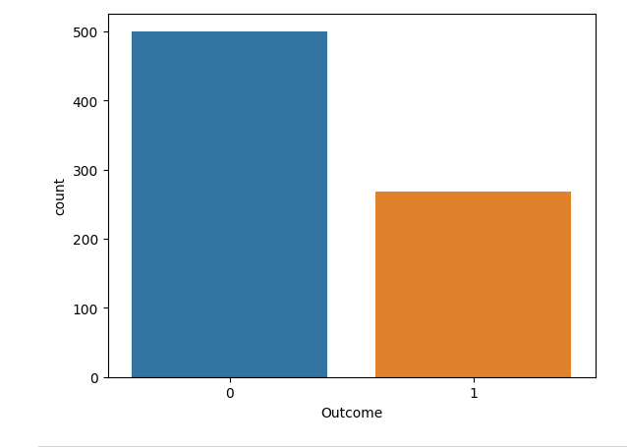
Data Visualization Count plot

Slide 14
CONCLUSION OF COUNT-PLOT
We observe that number of people who do not have diabetes is far more than people who do which indicates that our data is imbalanced.

Slide 15
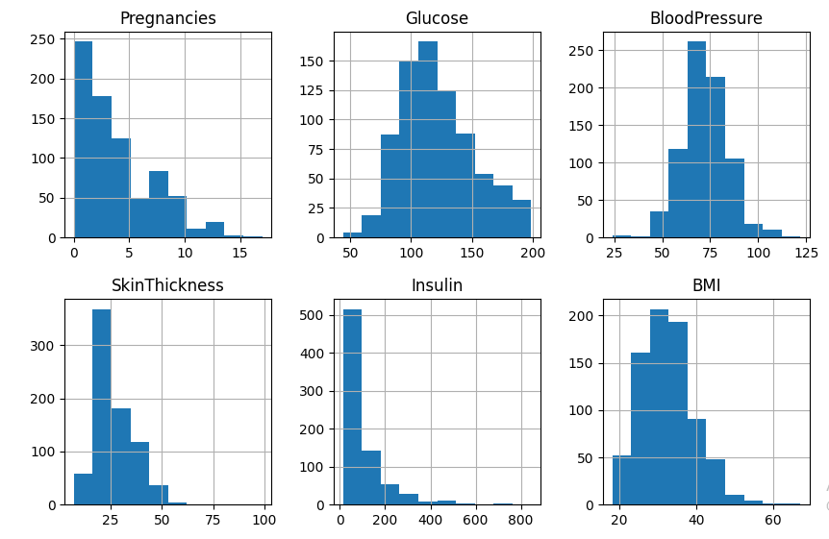
Histogram of each feature

Slide 16
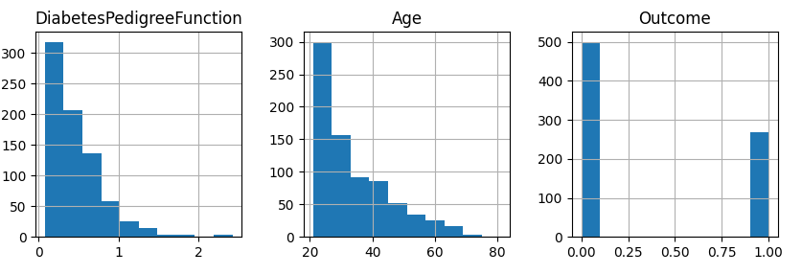
Histogram of each feature

Slide 17
CONCLUSION OF HISTOGRAM
We observe that only glucose and Blood Pressure are normally distributed rest others are skewed and have outliers

Slide 18
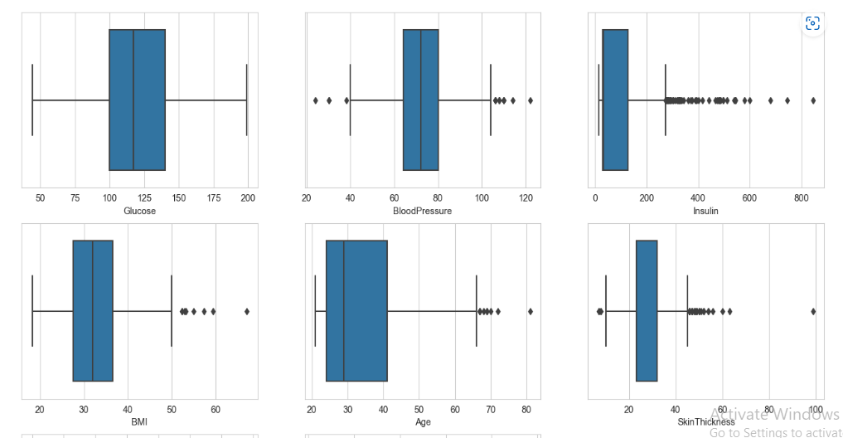
Boxplot of each feature

Slide 19
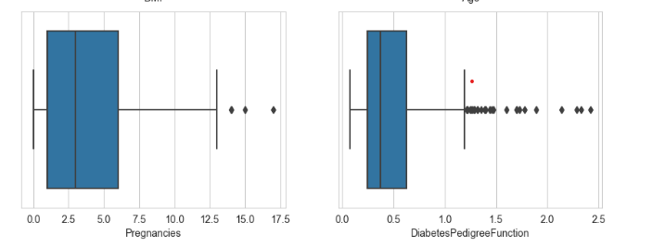
Boxplot of each feature

Slide 20
CONCLUSION OF BOX PLOT
Outliers are unusual values in your dataset, and they can distort statistical analyses and violate their assumptions. Hence it is of utmost importance to deal with them. In this case removing outliers can cause data loss so we have to deal with it using various scaling and transformation techniques.

Slide 21
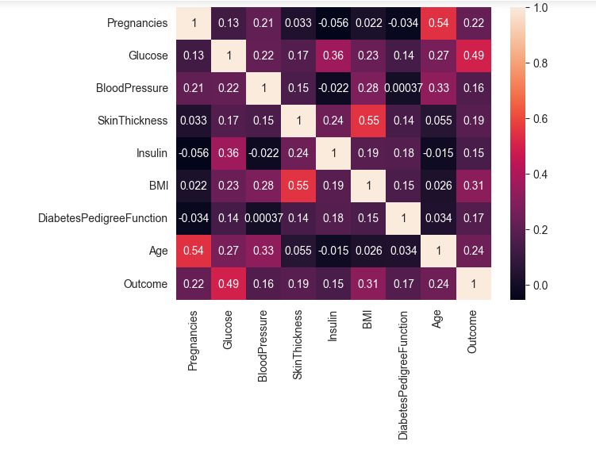
Feature Selection Heat-map

Slide 22
CONCLUSION OF HEAT-MAP
Observe the last row 'Outcome' and note its correlation scores with different features. We can observe that Glucose, BMI and Age are the most correlated with Outcome. Blood Pressure, Insulin, Diabetes Pedigree Function are the least correlated, hence they don't contribute much to the model so we can drop them.

Slide 23
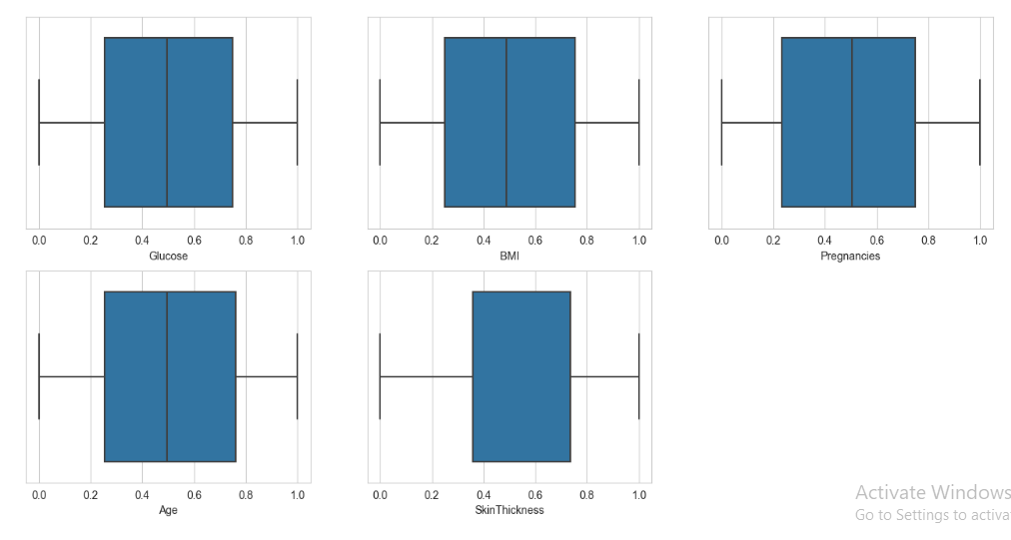
Handling Outliers

Slide 24
CONCLUSION OF OUTLIERS
This method transforms the features to follow a uniform or a normal distribution. Therefore, for a given feature, this transformation tends to spread out the most frequent values. It also reduces the impact of (marginal) outliers: this is therefore a robust preprocessing scheme.

Slide 25
Classification Algorithms
KNN
Naive Bayes
SVM
Random Forest
Multilayer Perceptron

Slide 26
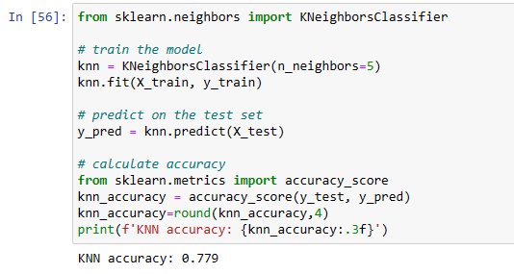
K-nearest neighbors (KNN)
KNN algorithm, is a non-parametric algorithm that classifies data points based on their proximity and association to other available data.

Slide 27
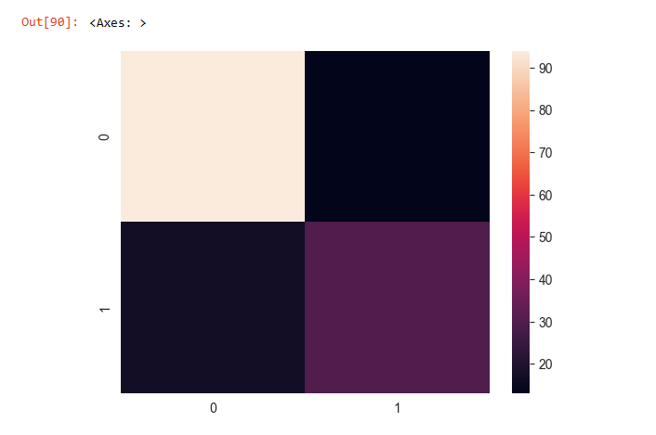
K-nearest neighbors (KNN)

Slide 28
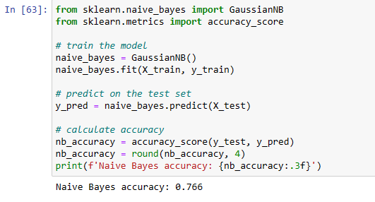
Naïve Bayes
Naive Bayes is classification approach that adopts the principle of class conditional independence from the Bayes Theorem. This means that the presence of one feature does not impact the presence of another in the probability of a given outcome, and each predictor has an equal effect on that result.

Slide 29
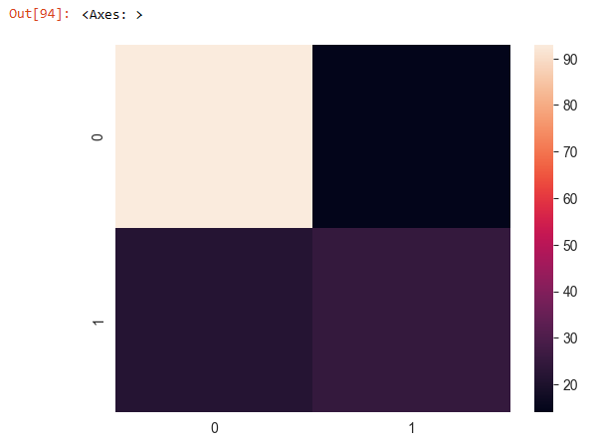
Naïve Bayes

Slide 30
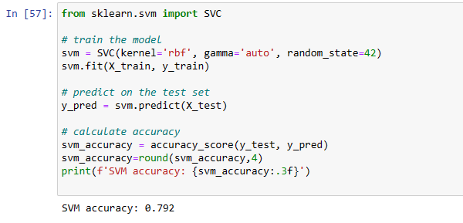
Support Vector Machine
It is typically leveraged for classification problems, constructing a hyperplane where the distance between two classes of data points is at its maximum. This hyperplane is known as the decision boundary, separating the classes of data points (e.g., has diabetes vs doesn't have diabetes ) on either side of the plane.

Slide 31
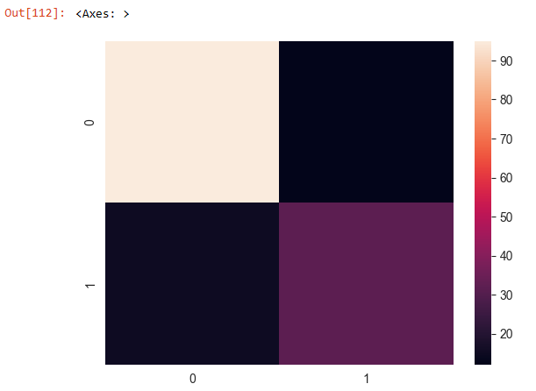
Support Vector Machine

Slide 32
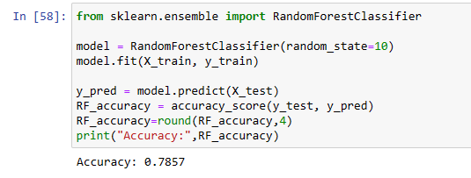
Random Forest
The "forest" references a collection of uncorrelated decision trees, which are then merged together to reduce variance and create more accurate data predictions.

Slide 33
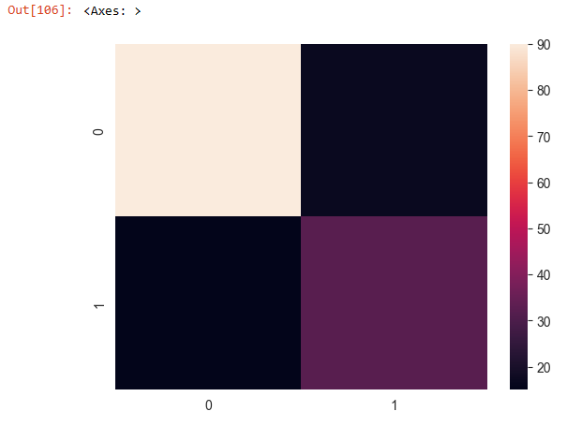
Random Forest

Slide 34
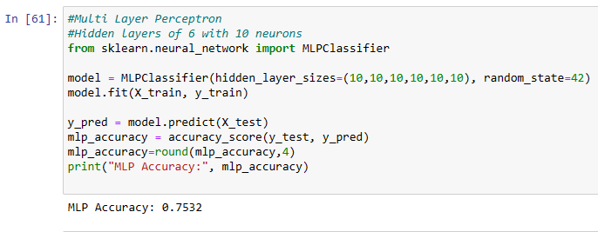
Multi-layer Perceptron
Multi-layer perception is also known as MLP. It is fully connected dense layers, which transform any input dimension to the desired dimension. A multi-layer perception is a neural network that has multiple layers. To create a neural network we combine neurons together so that the outputs of some neurons are inputs of other neurons.

Slide 35
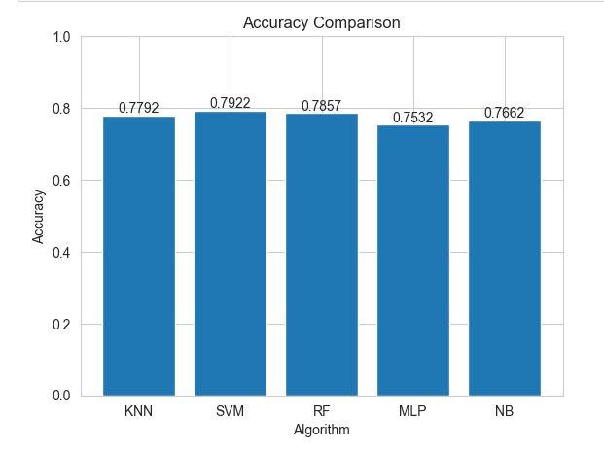
Results

Slide 36
GUIDE’S APPROVAL MAIL SCREENSHOT

Slide 37
REFERENCES
[1] John Daniels; Pau Herrero; Pantelis Georgiou IEEE Journal of Biomedical and Health Informatics ear: 2022 | Volume: 26, Issue: 1 Cited by: Papers (1)
[2] Hoda Nemat; Heydar Khadem; Mohammad R. Eissa; Jackie Elliott; Mohammed Benaissa IEEE Journal of Biomedical and Health Informatics Year: 2022 | Volume: 26, Issue: 6 |
[3] Henock M. Deberneh and Intaek Kim . Prediction of Type 2 Diabetes Based on Machine Learning Algorithm Int. J. Environ. Res. Public Health 2021, 18, 3317. https://doi.org/10.3390/ijerph18063317
[4] (jsparab@unigoa.ac.in) Jivan Parab; Marlon Sequeira; Madhusudan Lanjewar; Caje Pinto; Gourish Naik IEEE Journal of Translational Engineering in Health and Medicine Year: 2021 | Volume: 9 Cited by: Papers (1)

Slide 38
REFERENCES
[5] Usama Ahmed;Ghassan F. Issa; Muhammad Adnan Khan; Shabib Aftab;Muhammad Farhan Khan; Raed A. T. Said;Taher M. Ghazal Munir Ahmad IEEE Access Year: 2022 | Volume: 10 Cited by: Papers (2)
[6] Maryamsadat Shokrekhodaei; David P. Cistola; Robert C. Roberts; Stella Quinones IEEE Access Year: 2021 Cited by: Papers (6)
[7] Egidio Gomes Filho; Plácido Rogério Pinheiro; Mirian Caliope Dantas Pinheiro; Luciano Comin Nunes; Luiza Barcelos Gualberto Gomes IEEE Access Cited by: Papers (9)
[8] G. Geetha, K.Mohana Prasad, Prediction of Diabetics using Machine Learning International Journal of Recent Technology and Engineering (IJRTE) ISSN: 2277-3878, Volume-8 Issue-5, January 2020

Slide 39
REFERENCES
[9] Daniels, John, Pau Herrero, and Pantelis Georgiou. "A Multitask Learning Approach to Personalized Blood Glucose Prediction." IEEE Journal of Biomedical and Health Informatics 26, no.1(2021): 436-445.
[10] Nemat, Hoda, Heydar Khadem, Mohammad R. Eissa, Jackie Elliott, and Mohammed Benaissa. "Blood Glucose Level Prediction: Advanced Deep-Ensemble Learning Approach." IEEE Journal of Biomedical and Health Informatics (2022).
[11] Tašić, Jelena, György Eigner, and Levente Kovács. "Review of Algorithms for Improving Control of Blood Glucose Levels." In 2020 IEEE 18th International Symposium on Intelligent Systems and Informatics (SISY), pp. 179-184. IEEE, 2020
[12] Beneyto, Aleix, Arthur Bertachi, Jorge Bondia, and Josep Vehi. "A new blood glucose control scheme for unannounced exercise in type 1 diabetic subjects." IEEE Transactions on Control Systems Technology 28, no. 2 (2018): 593-600.

Slide 40
REFERENCES
[13] Ahmed, Usama, Ghassan F. Issa, Muhammad Adnan Khan, Shabib Aftab, Muhammad Farhan Khan, Raed AT Said, Taher M. Ghazal, and Munir Ahmad. "Prediction of diabetes empowered with fused machine learning." IEEE Access 10 (2022): 8529-8538.
[14] Aliberti, Alessandro, Irene Pupillo, Stefano Terna, Enrico Macii, Santa Di Cataldo, Edoardo Patti, and Andrea Acquaviva. "A multi-patient data-driven approach to blood glucose prediction." IEEE Access 7 (2019): 69311-69325.
[15] Jia, Liyan, Zhiping Wang, Siqi Lv, and Zhaohui Xu. "PE_DIM: An Efficient Probabilistic Ensemble Classification Algorithm for Diabetes Handling Class Imbalance Missing Values." IEEE Access 10 (2022): 107459-107476.

Slide 41


